Slide 1

Security Awareness

Slide 2
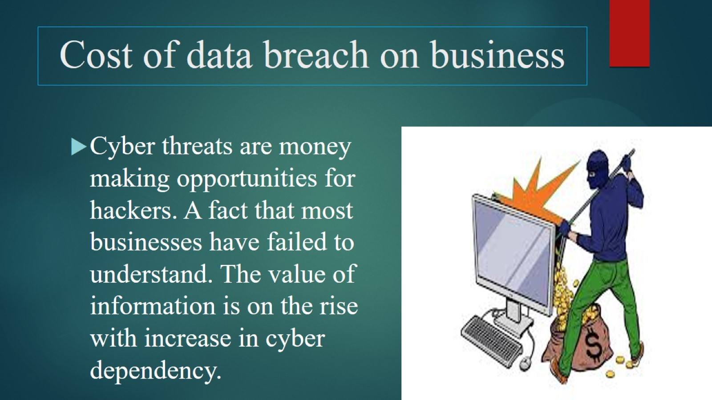
Cost of data breach on business

Slide 3
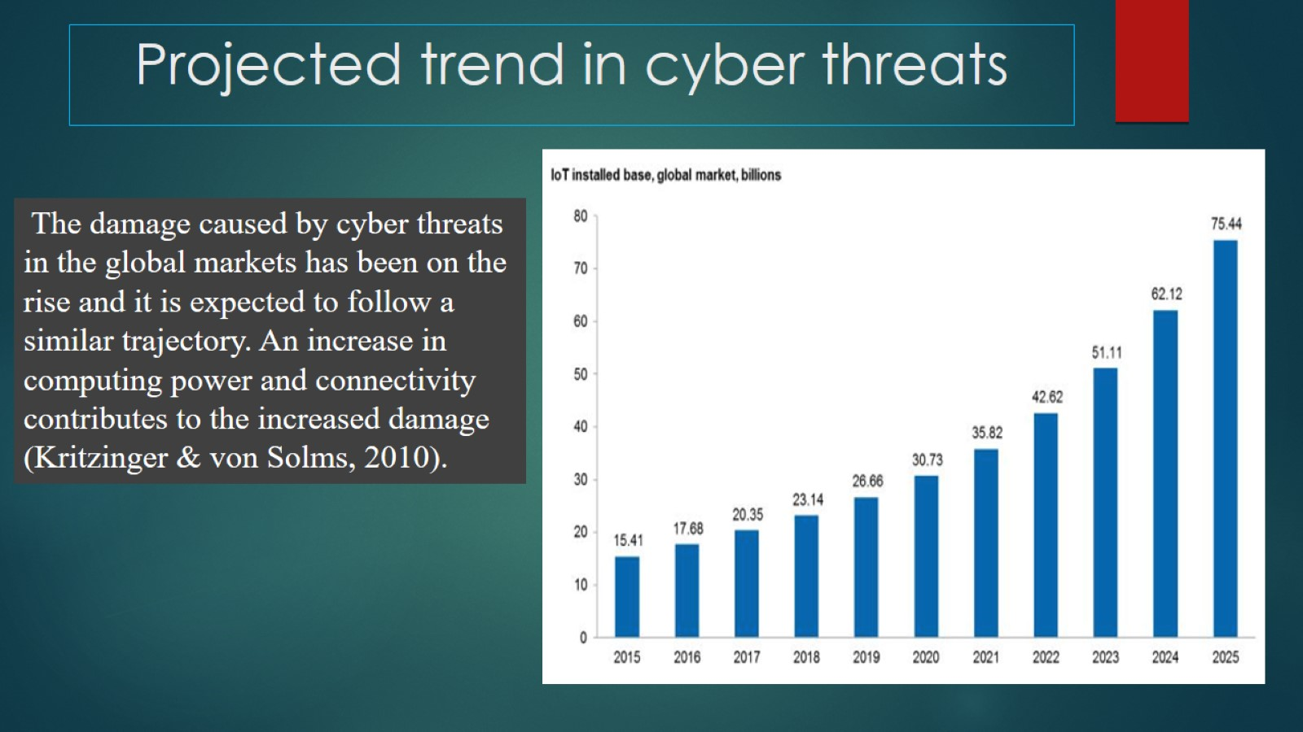
Projected trend in cyber threats

Slide 4
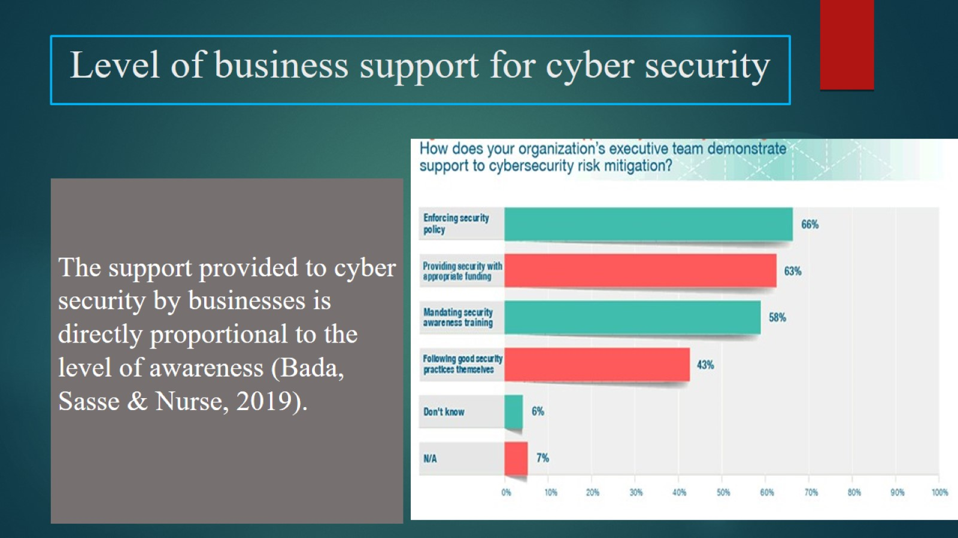
Level of business support for cyber security

Slide 5
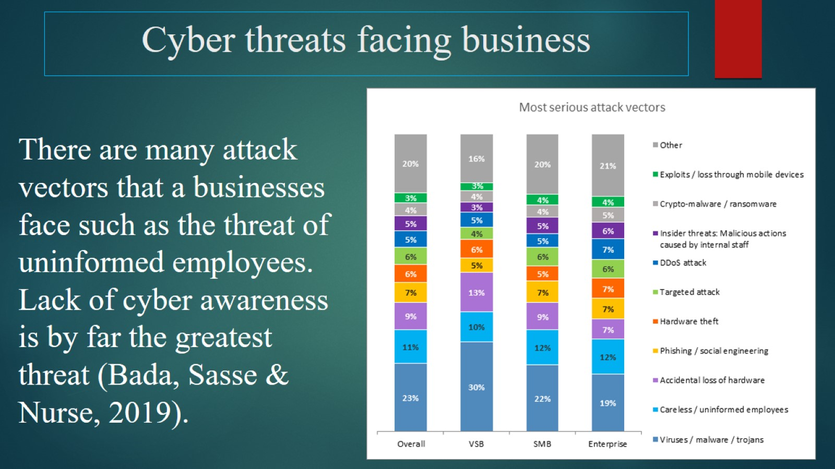
Cyber threats facing business

Slide 6
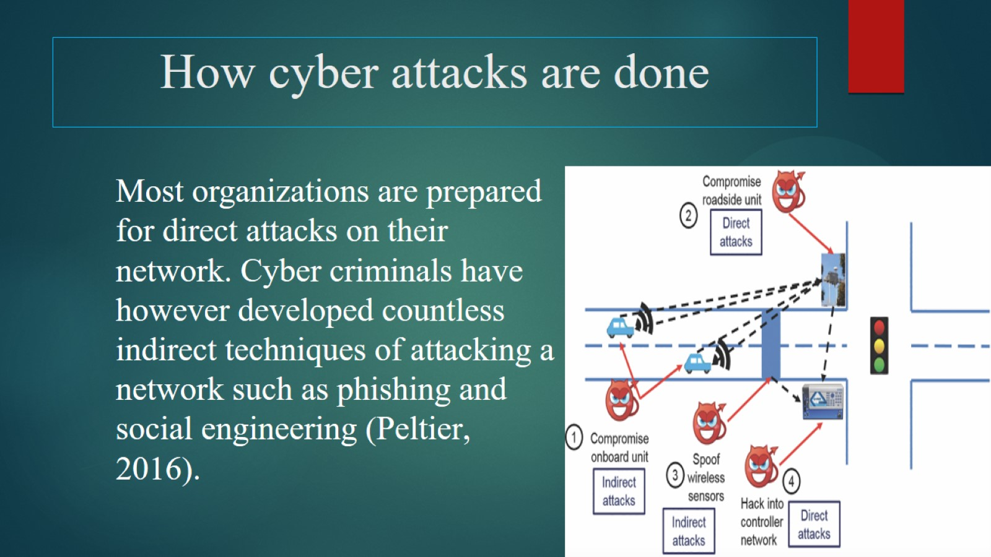
How cyber attacks are done

Slide 7
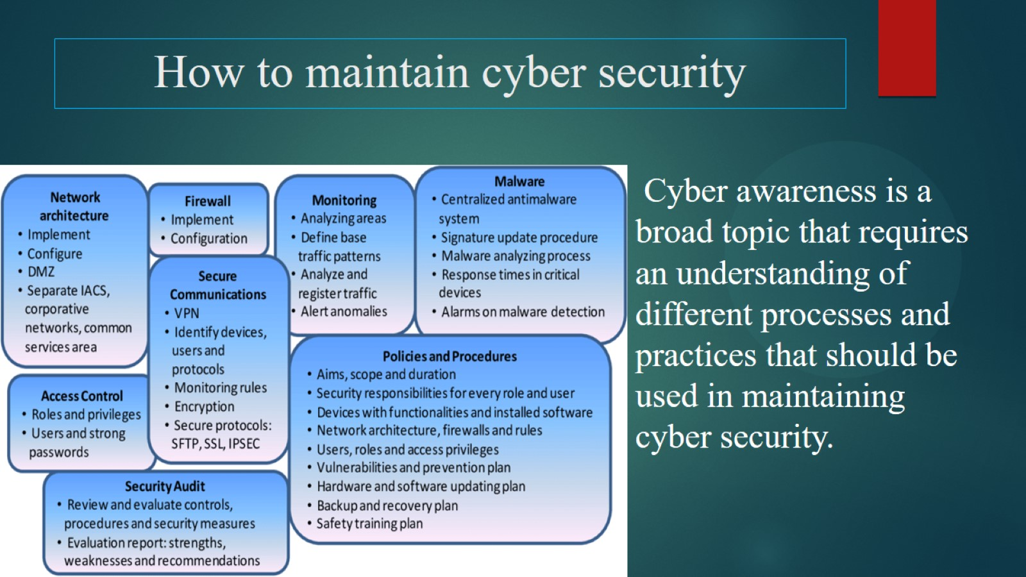
How to maintain cyber security

Slide 8
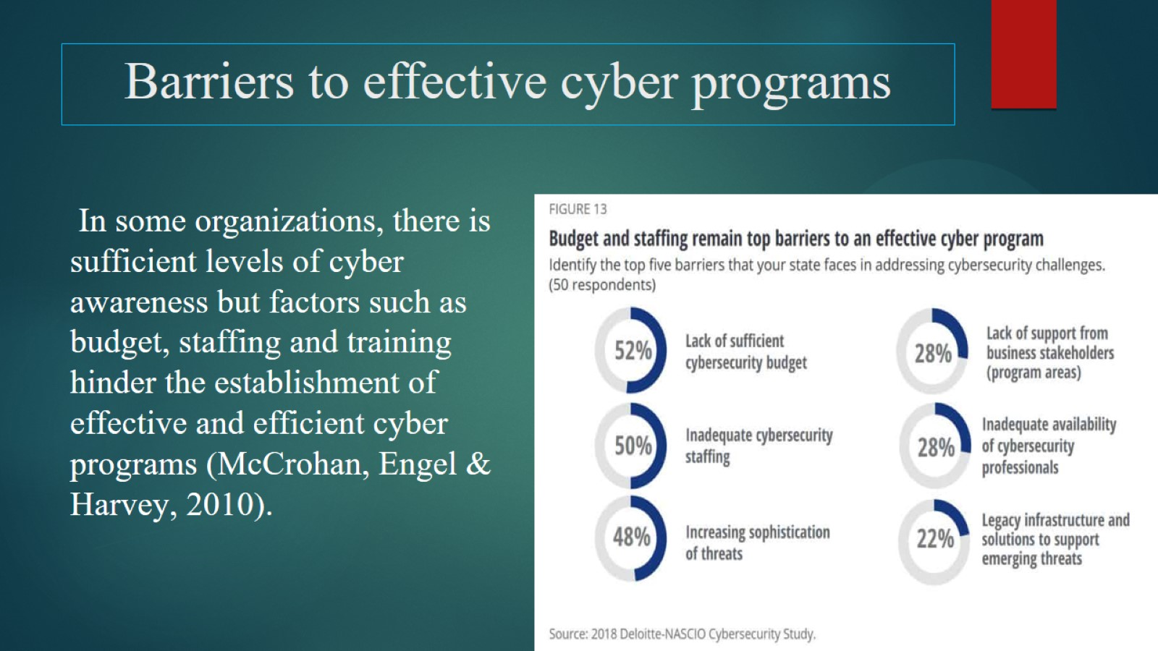
Barriers to effective cyber programs

Slide 9
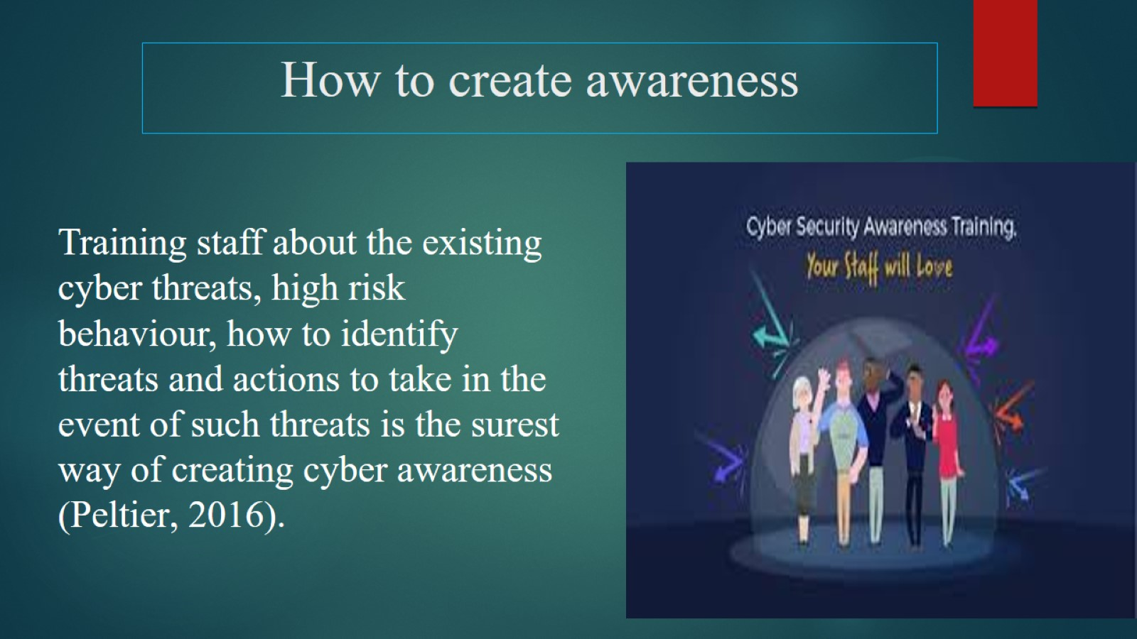
How to create awareness

Slide 10
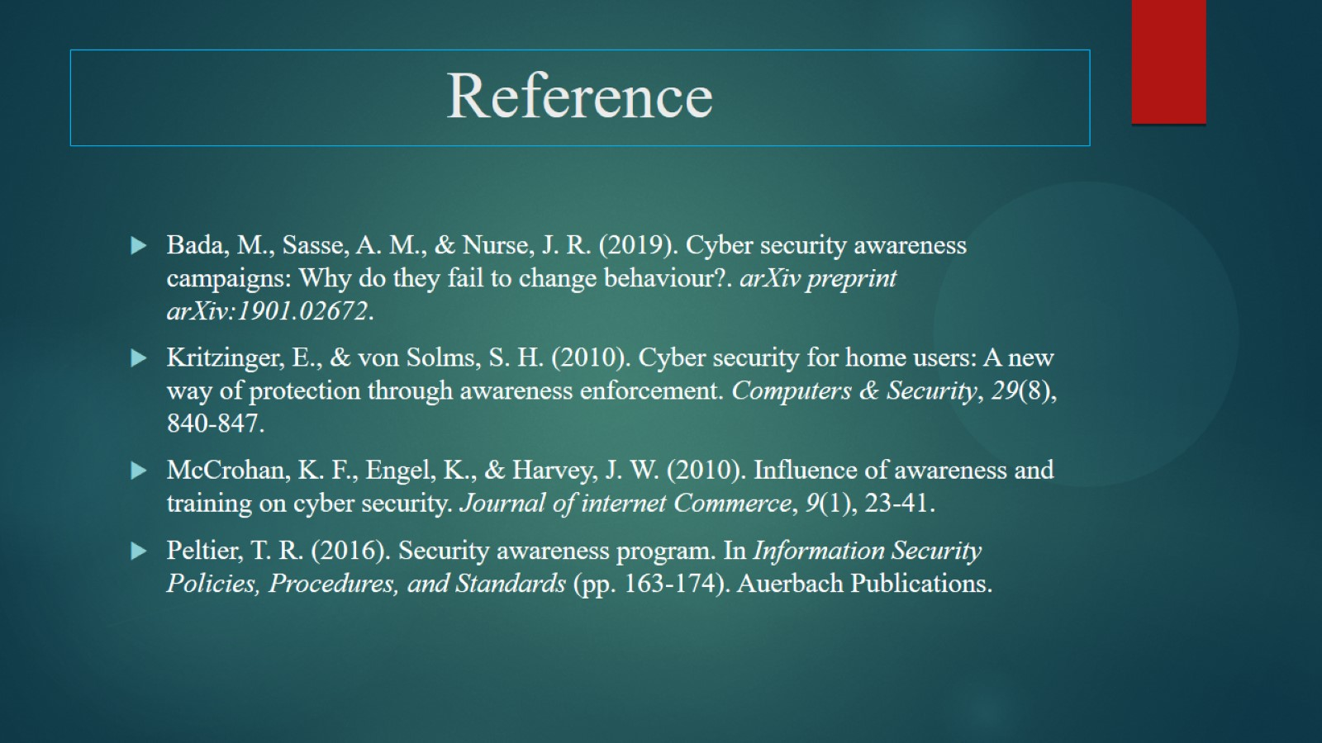
Reference

